Slide 1


U.S. Army PEOSTRI – Process Workflow Application
Braden Cariaga
&
Henry Thiel

Slide 2
Today's Agenda
Key takeaways:
Brief Project Overview
Project Gantt Chart
Functional Decomposition
Data Flow Diagram – Context
Data Flow Diagram – Level 0

Slide 3
Project Overview
Our team has been tasked with creating an enterprise application to improve process and project workflow which enables logisticians to populate the status of requirements and sub-requirements for PEO STRI workflow processes.

Slide 4
Gantt Chart Phases
Phase 1 – Requirements Analysis
Phase 2 - Design
Phase 3 - Development
Phase 4 - Testing
Phase 5 - Deployment

Slide 5
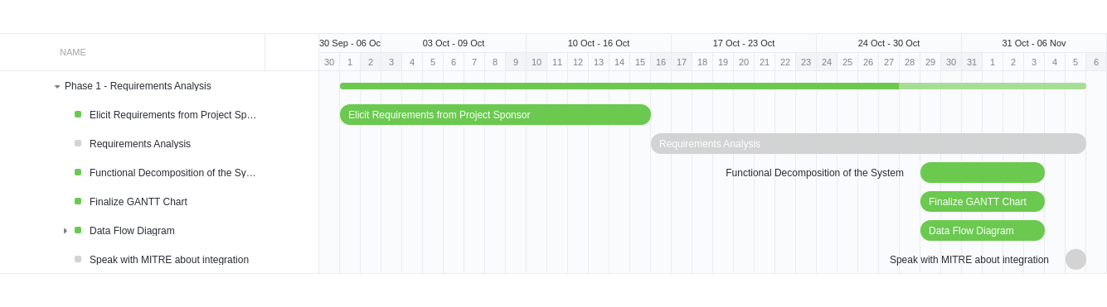
Project Gantt Chart – Phase 1

Slide 6
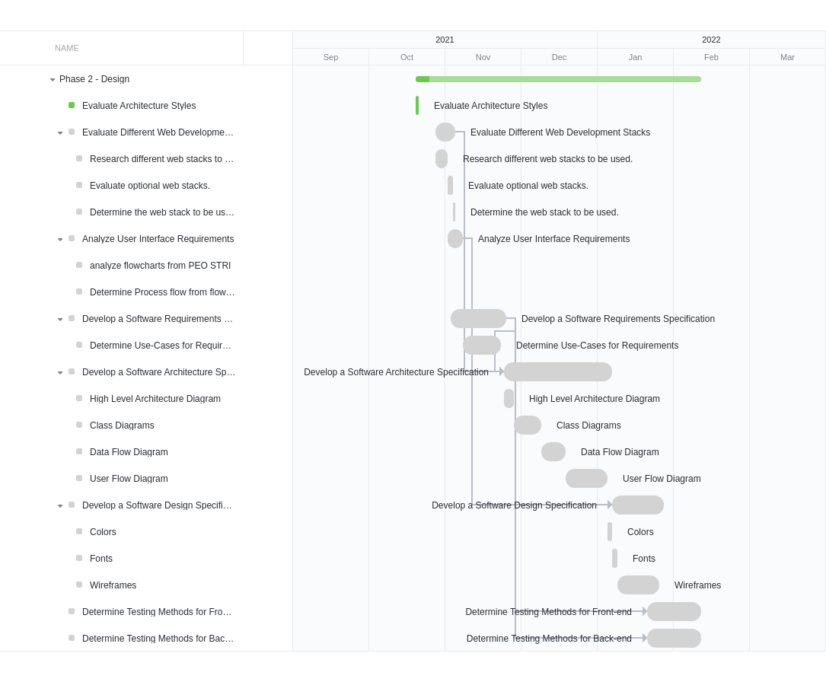
Project Gantt Chart – Phase 2

Slide 7
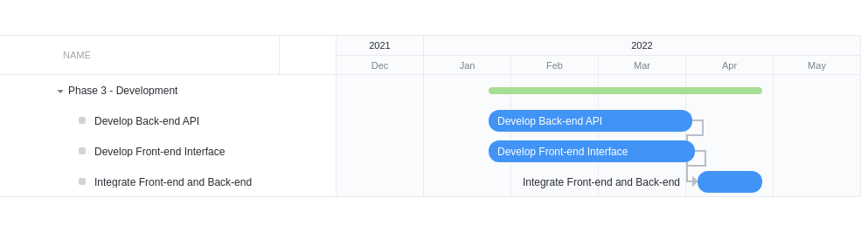
Project Gantt Chart – Phase 3

Slide 8
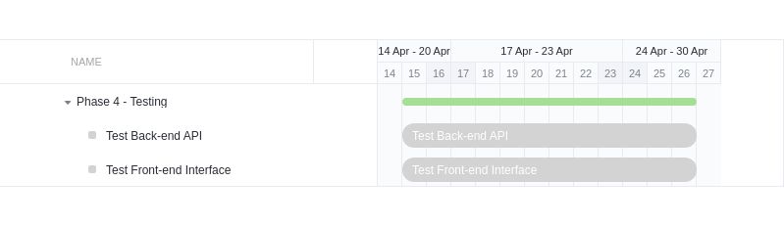
Project Gantt Chart – Phase 4

Slide 9
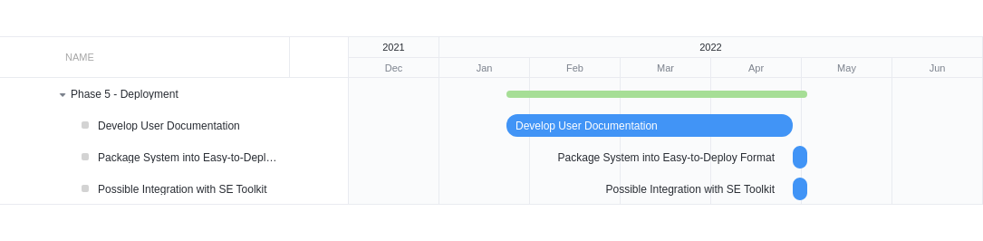
Project Gantt Chart – Phase 5

Slide 10
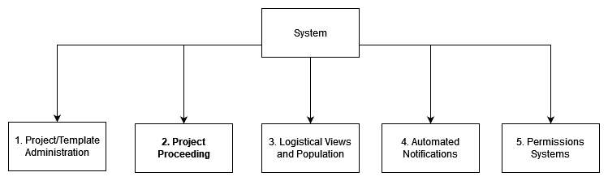
Main Functions of the System

Slide 11
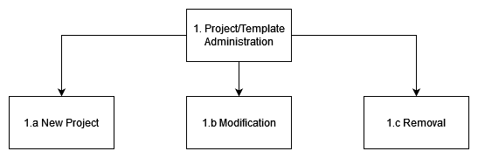
1. Product/Template Administration

Slide 12
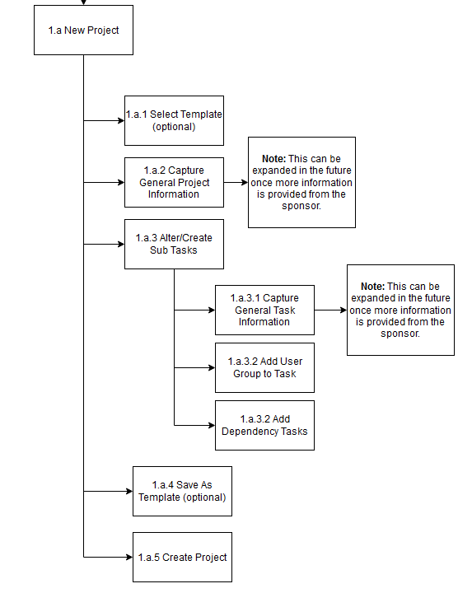
1.a New Project/Template
Templates are created and managed by administrators
Project information can be collected during the project's lifespan

Slide 13
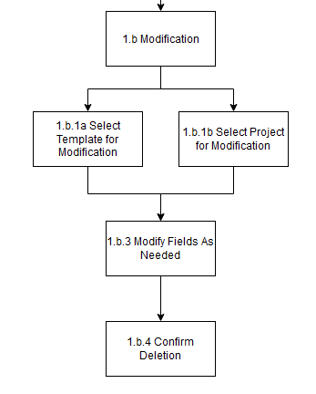
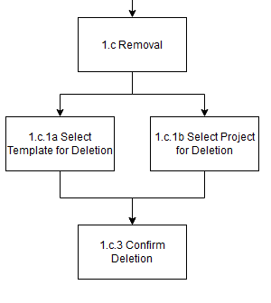
1.b Modification & 1.c Removal
Users will require permissions to modify projects
Deletions and modifications will be logged

Slide 14
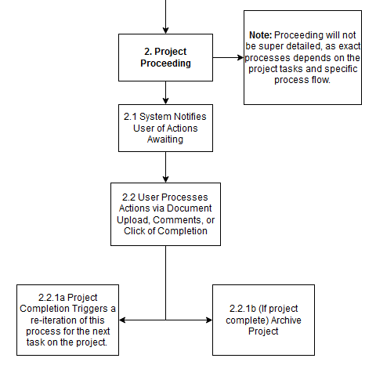
2. Project Proceeding
Notifications will be displayed to the user in the system or sent via email
Archived projects can be automatically deleted

Slide 15
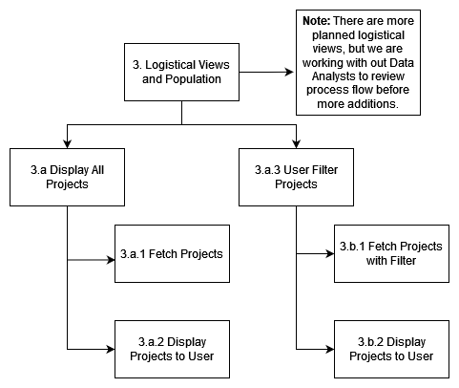
3. Logistical Views and Population
Logistical views are displayed to users assigned to the project and higher-level approvers

Slide 16
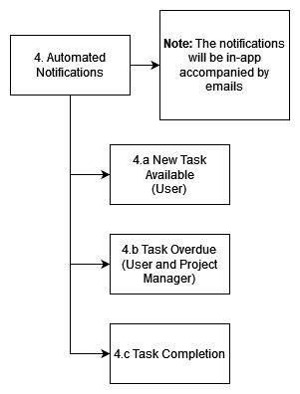
4. Automated Notifications

Slide 17
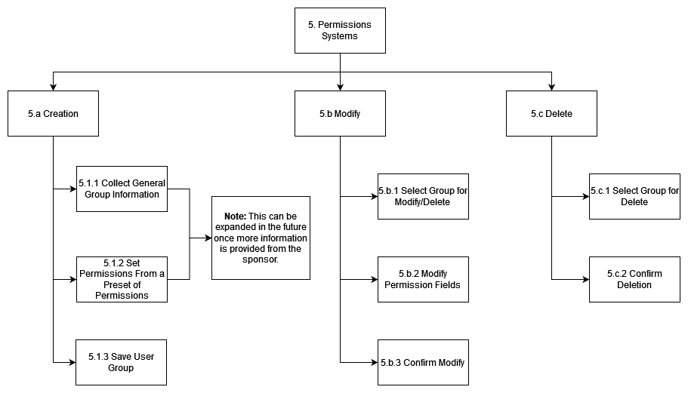
5. Permissions System
Permissions can be assigned to specific user groups

Slide 18
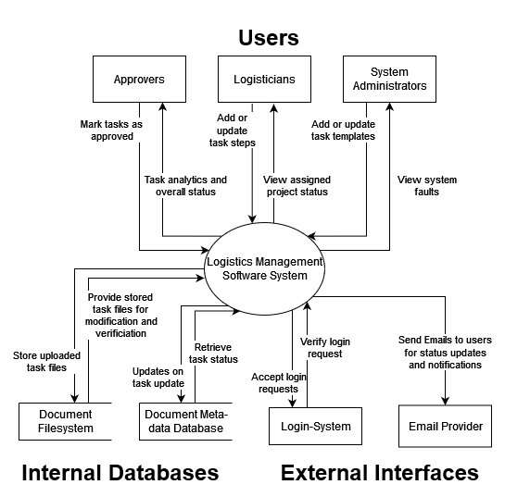
Data Flow – Context Diagram

Slide 19
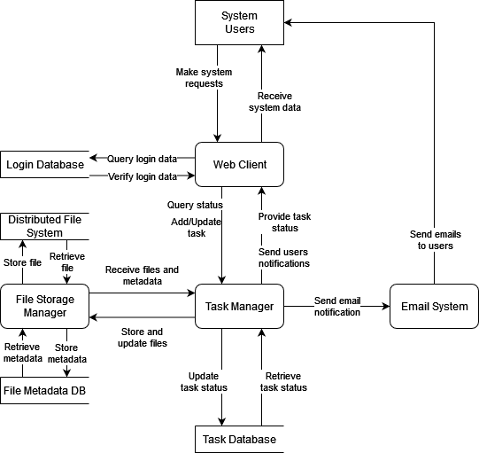
Data Flow – Level 0

Slide 20
Any Questions?
Thank you for your time!
Braden Cariaga
Henry Thiel
Computer Scientist
Computer Scientist

